Slide 1

Supporting Alfresco
@binduwavell, Chief Architect @ Zia Consulting
Notes:
Platinum Alfresco partner. The only US partners providing Level 1 Alfresco support?

Slide 2

Agenda
Investigating and resolving Alfresco Issues
Getting the most from Alfresco Support
Getting the most from JIRA Tickets

Slide 3

Investigating and resolving Alfresco Issues

Slide 4
First
Use supported versions!
Follow Day Zero Guide!
Notes:
We don't see many issues caused by running on unsupported platforms. Unsupported major versions have caused issues, although unsupported minor versions are usually OK. If you haven't made sure this is true, you will always wonder if your issues are tied to environments.
No longer documented with this name. Alfresco is delivered with defaults that work well for development. Need to make sure that prereqs are all right and production configuration changes have been performed.

Slide 5
Simple Things
When did the problem start?
What changed?
Remove as many variables as possible
Find steps to reproduce
Notes:
You may have to review logs, run scripts and/or queries and talk with your users. Ideally you can establish and maintain a detailed timeline for your issue.
When something was working and then broke, what changed near when the issue started?
Bypass the load balancer and other network infrastructure with an SSH tunnel. Bypass non default authentication. Disable custom code. For API issues, can you reproduce via Share?
This is not always possible, it will likely help a lot if you have them. If an issue is intermittent attempt to characterize how frequently the issue happens.

Slide 6
Common Issues
Folders with too many direct children
Low on resources
Separate Alfresco & Solr
Notes:
There are no official limits and to some extent they depend on your infrastructure. If you have 1,000 or more direct children, consider restructuring. If you have 2,000 or more direct children, you may run into issues every now and then. If you have 10,000 or more direct children, you will see issues. We have had customers with over 17m direct children, it was possible to resolve this, was very painful!
Low resources: Could be disk or memory.Make sure network to storage and DB is solid!
Alfresco & Solr GC profiles are very different and interfere with each other. Should use Concurrent Mark Sweep for Solr.

Slide 7
Common Issues
Use appropriate storage
Pin memory when using virtual machines
Increase cluster timeouts
Notes:
Solr indexes should be on fast local storage (ideally SSD). Content cache can be on slower disk. Database should not use RAID 5!
Java behaves very badly in virtual environments if memory is not pinned. This is difficult to debug and even justify via monitoring, just do the right thing!
ENTERPRISE: Is your database choking, it might be your cluster config!
alfresco.hazelcast.max.no.heartbeat.seconds=300
alfresco.clusterCheck.timeout=90000
JAVA_OPTS="-Dhazelcast.jmx=true -Dhazelcast.jmx.detailed=true”

Slide 8
Tools
Support Tools add-ons
Log files
JMX Dump
Notes:
There has been an enterprise support tools add-on for a few years: https://github.com/Alfresco/alfresco-support-tools. Now integrated into Alfresco 5.2. OOTBee Support Tools for Community (and Enterprise): https://github.com/OrderOfTheBee/ootbee-support-tools.
Understand log levels, enable targeted loggers. If necessary, up the root logger, reproduce the issue and reset the root logger. You can change log levels without restarting with Support Tools Add-Ons. OOTBee Support Tools can add new loggers not just change existing loggers.
Search through logs, use editor like Vim or possibly: http://www.logsniffer.com/. Alfresco's default log format is: `%d{yyyy-MM-dd} %d{ABSOLUTE} %-5p [%c] [%t] %m%n`
JMX dumps are helpful when you have limited or no access to the machines you must support. Help you compare the runtime environment to what you think the environment should be. http://localhost:8080/alfresco/service/api/admin/jmxdump
ENTERPRISE: http://localhost:8080/alfresco/service/enterprise/admin (JMX Dump)

Slide 9
Tools
Node Browser
JavaScript Console
API Explorer
Notes:
Use node browser to check properties, aspects, relations, queries, target DB or Index.
JSConsole is invaluable for setting up test fixtures for reproducing issues. Great for triggering code paths reliably.
API Explorer includes runnable API examples, easy to find out if API is working as desired without custom code.

Slide 10
Tools
CMIS Workbench
JConsole / JVisualVM
JStack -l
Notes:
Reproduce with CMIS Workbench. Helps understand if custom app is at fault or not. Groovy console is very helpful.
Monitor memory and CPU usage. Consider the shape of the memory graphs. Consider VisualGC in JVisualVM when investigating memory issues.
ENTERPRISE (live): Review and change configurations. WARNING: Configuration changes supersede properties files! Disable/enable subsystems. Trigger actions.
-l option helps find locking issues. Use tools to summarize stacks. Take several stack shots at regular intervals. Use tools to compare stacks to find long running code and code that is being run very frequently.

Slide 11
Getting the most from Alfresco Support

Slide 12
Severity Levels
Production System Down
Major Impact
Minor Impact
Questions & Enhancements
Notes:
http://docs.alfresco.com/support/concepts/su-severity-defs.html
P1 includes system in final stages of testing
P2 includes time sensitive questions impacting performance or deliverables
P3 covers situations where production may be moderately impacted
P4 low to no impact: just askin’

Slide 13
Issue Template
Description
Steps to reproduce
Expected behaviour
Observed behaviour
Analysis to date
Business impact [optional]
Desired outcome from ticket [optional]
Notes:
Description is concise (but complete)
Minimal steps to reproduce

Slide 14
Attachments
JMX dump
Bounded logs
Specialized configuration files
Notes:
JMX provides a bunch of info that can help with issue triage and investigation in one place.
Ideally log files will cover the period of the issue plus a little bit before and after. Logs when the system is working and from when it is not working are helpful.
Other config like share-config-custom, solrcore.properties, etc are not in the JMX dump, so must be added as well when the issue warrants these items.

Slide 15
Severity 1
Write up a ticket (using template)
Pick up the phone and call support!

Slide 16
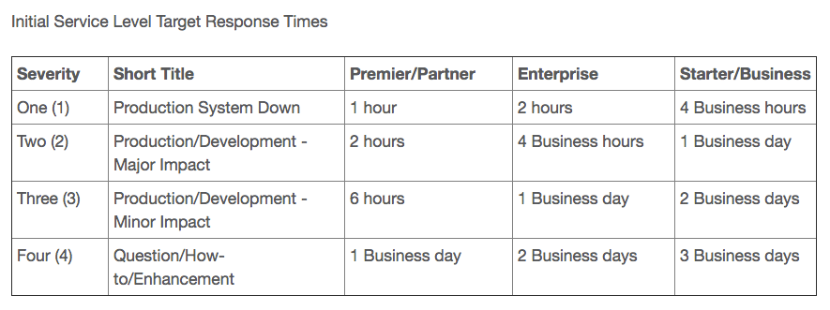
Service Level Targets
Notes:
http://docs.alfresco.com/support/concepts/su-slo.html
These are targets not commitments. Initial response target depends on severity and license type (Premier/Partner, Enterprise, Starter/Business).

Slide 17
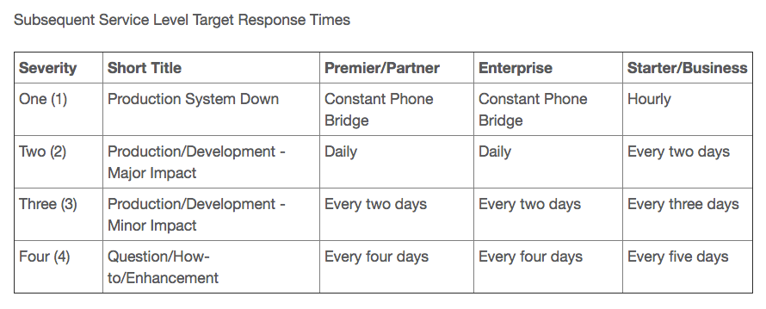
Service Level Targets
Notes:
http://docs.alfresco.com/support/concepts/su-slo.html
Subsequent responses are gated by the same two factors.

Slide 18
Tips
Be kind and responsive
Put tickets on hold if you are busy
Understand response times
Re-opening tickets
Notes:
You will likely receive better results if you are civil and also respond quickly to feedback/suggestions/requests. The longer you take to respond, the further out of mind your ticket becomes.
You can put a ticket on hold for upto 2 weeks if you are busy. As soon as you comment on the ticket it will be taken off of hold. Remember, the longer you take to respond, the further out of mind your ticket becomes.
If Alfresco is waiting on you, they will likely ping you daily for 5 days and close the ticket if you have not responded.
Comment on the ticket within 30 days of close and it will re-open. If it's been more than 30 days, make a new ticket and reference the previous ticket number.

Slide 19
Getting the most from JIRA Tickets

Slide 20
Remember
ALF issues are conversations
Community-only issues
Use community for support
Notes:
If you are not responsive the issue will be closed. If issue is closed, and you disagree, re-open it. This signals that someone cares.
There is a limit to effort for community raised issue. There are real issues that Alfresco doesn't have the opportunity to fix due to complexity or because it is an area that isn't currently prioritizing.
ENTERPRISE: issues should be reported though support.
JIRA is for bug reports.

Slide 21
Issue Reporting
Only new issues
Investigate before reporting
Don't like the design? Not a bug!
See support issue template above
Notes:
https://community.alfresco.com/docs/DOC-6263-reporting-an-issue
Make sure your issue has not been reported previously. If you find an existing issue, add any details that will help, such as your environment if different than what has already been reported.
The easier you make it to reproduce on an un/minimally customized version of latest release, the higher your odds.
Enhancement requests rarely prioritized from JIRA. Either make the enhancement via an add-on or purchase a support contract and request via support.

Slide 22
Issue Triage
Fortnightly review
Fast decisions
Patches improve success
Provide affectsVersion
Notes:
https://community.alfresco.com/docs/DOC-6285-issue-triage-process

Slide 23
Old Issues Closed
Issues over a year old, with no affectsVersion provided
Issues with affectsVersions that only contain unsupported versions of Enterprise Edition
Issues with affectsVersions that only contains releases of Alfresco Community Edition older than two releases back.
Notes:
https://community.alfresco.com/docs/DOC-6285-issue-triage-process

Slide 24
Thank You!
bindu@ziaconsulting.com
@binduwavell

